Slide 1
Flow ARM Connector: Simple is Good
Konstantin Kaminskiy for NYC Power Platform User Group, 10/2/2019

Slide 2
Who Am I?
Konstantin Kaminskiy
MSPs
Office365, Azure, PowerShell
Recently passed AZ-103
Please interrupt

Slide 3
What and Why
What: ARM Connector for Flow / LogicApps.
Get data
Preform an operation
Deploy a resource
Why: You want data about an Azure resource, or you want to do something to it, from a Flow.
Alternatives require the use of Azure Automation Runbooks / Azure Functions
In the case of Azure Automation, cost can become a factor
Complexity is increased
ARM Connector in your Flow is a more direct approach

Slide 4
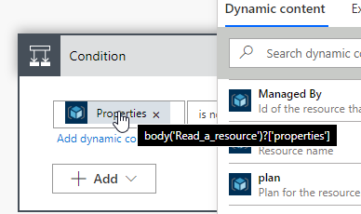
How – Getting Data
Read a resource action
Resource Provider & Short Resource Id: Get with Azure PowerShell or Azure CLI, or from the portal url.
Client API Version: Google the Resource Provider followed by “ARM template reference” to get from Microsoft docs or enter whatever and get from error.
Digging deeper – particular property
Examine output of Read a resource
Examine the expression behind the dynamic content
Make your own expression

Slide 5
How – Start/Stop VM
Invoke resource operation action
The only new field is “Action name”
Get actions from resource provider operations: https://docs.microsoft.com/en-us/azure/role-based-access-control/resource-provider-operations
Get from az cli commands, naming seems consistent

Slide 6
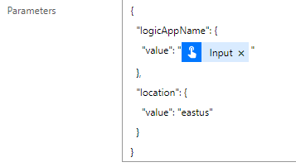
How – Deploy a Template
Create or update a template deployment action
Resource group level only at this time, but can create a resource group with another action
Can use either uris for the template and parameters, or paste them in.
URIs seem to be a lot more straightforward
The syntax for parameters is non-obvious, and the documentation seems to be non-existent

Slide 7
Questions?
Konstantin Kaminskiy
Konstantin.Kaminskiy@outlook.com
@KonTheCat
Blog.konthecat.com

